Slide 1


IX Encuentro Argentino de Transporte Fluvial
Desafíos del transporte marítimo y la gobernanza portuaria en Suramérica
Ricardo J. Sánchez
División de Recursos Naturales e Infraestructura
CEPAL | Naciones Unidas

Slide 2
LAC: Diagnosis and major infrastructure challenges
Physical restraint & shortage => investments and funding
High dispersion and multiplicity of views in public & private action
Failures and regulatory / institutional barriers
Weakness or absence of sustainability criteria

Slide 3
Latin America: infrastructure investment by sector,
1980-2012*, (percentage of GDP)
Source: Unidad de Servicios de Infraestructura de la División de Recursos Naturales e Infraestructura de CEPAL.

Slide 4
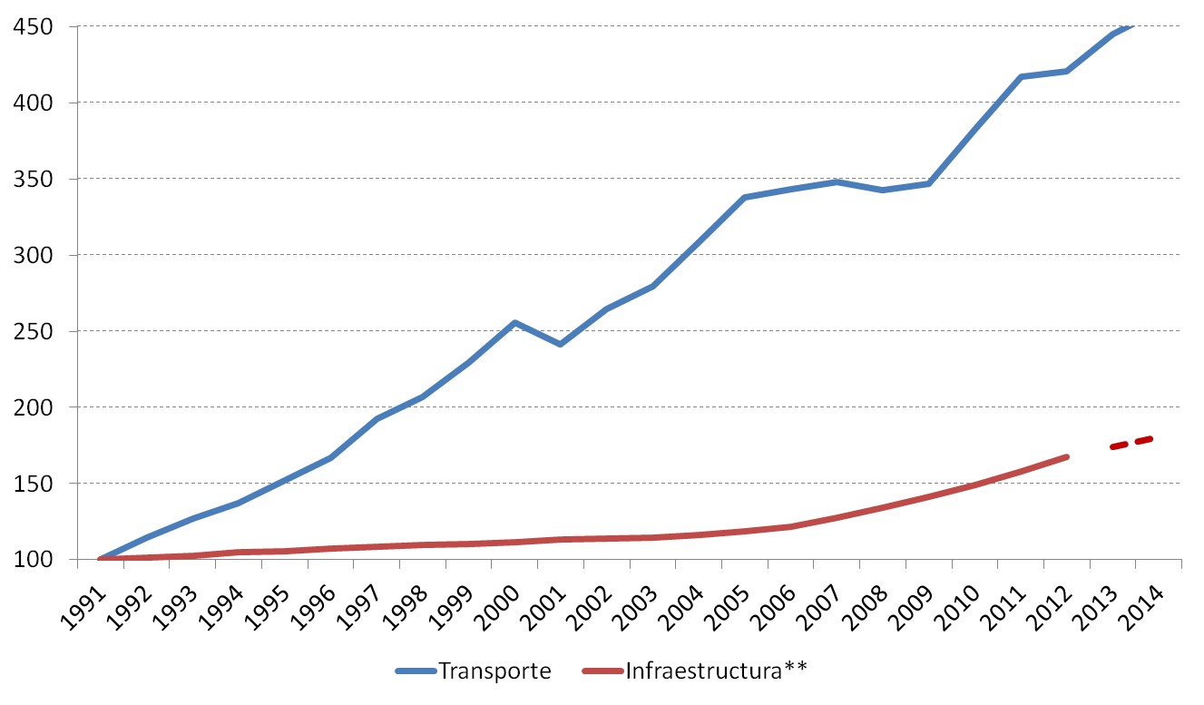
Evolution of supply and demand “feeds” the transport infrastructure gap (base year 1990=100)
Source: Infrastructure Services Unit on their own preliminaries data, from Calderón & Servén (2010) CEPAL (2011) and ongoing joint studies with CAF and BID & World Trade Monitor. Preliminary estimation.
Notes: * Countries are Argentina, Brazil, Chile, Colombia, Mexico y Peru. Since 2003, Bolivia, Costa Rica, Ecuador, El Salvador, Guatemala, Nicaragua, Panamá y Paraguay are included as well. ** Data in the last two years are a projection, using the average in the last ten years.

Slide 5
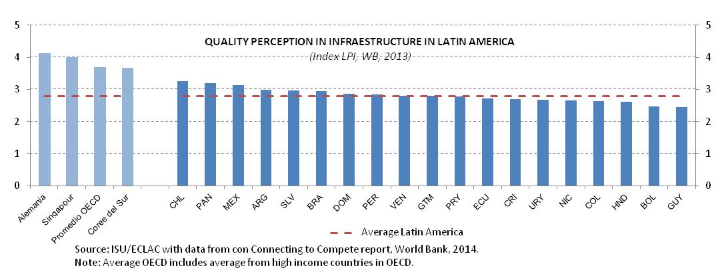
LAC: Status of infrastructure (2012)
TRAFFIC DENSITY 2011-2012
(Total red by 100 km2)
RAIL NETWORK EVOLUTION 2007-2012
(km)
Average Latin America (2012)

Slide 6
Modal distribution and its evolution unfavorable to the competitiveness and sustainability
Modal transport distribution in imports &exports in South America
(Volume, Thousand tons)
Air
Source: USI/ECLAC, BTI, 2015
Note: Includes Argentina, Brazil, Chile, Colombia, Ecuador, Paraguay, Peru and Uruguay

Slide 7
sustainability of infrastructure logistics and mobility
efficiency and competitiveness
increasing energy costs
investment into energy infrastructure
long term economic efficiency
human capital and resource management
carbon footprint
social costs (accidents, security)
infrastructure governance

Slide 8
Logistics strategy and planning in Latin America
Infrastructure, transport and logistics, are mutually dependent and therefore produce complex issues require holistic analysis and integrated solutions.
Globalized and competitive markets, require continued improvements in the quality of the products and price, hence the importance of logistics planning.
Logistics strategies and planning in particular, has been absent from public policy.
Most countries still develop transport policies focus in one mode and not in terms of the overall competitiveness, efficiency and applying sustainability criteria
Very few countries monitor their progress and advances in logistics performance

Slide 9
Maritime transport and the crisis: main facts of 2014
Is it the end of the crisis? a challenging macroeconomic environment but some positive lights,
bunker prices: a short fresh breath,
a chronic overcapacity in the key east-west trade arteries which disturbs the supply-demand equilibrium,
the cascading effects of this overcapacity which could, in effect, jeopardise the profitability of other trade lanes,
a overhang of orders that is due to be delivered and, may yet, present the biggest threat to all freight rate recovery efforts.
better profits for a set of companies (as an industry average)
process of mergers, acquisitions and alliances will be strengthened.

Slide 10
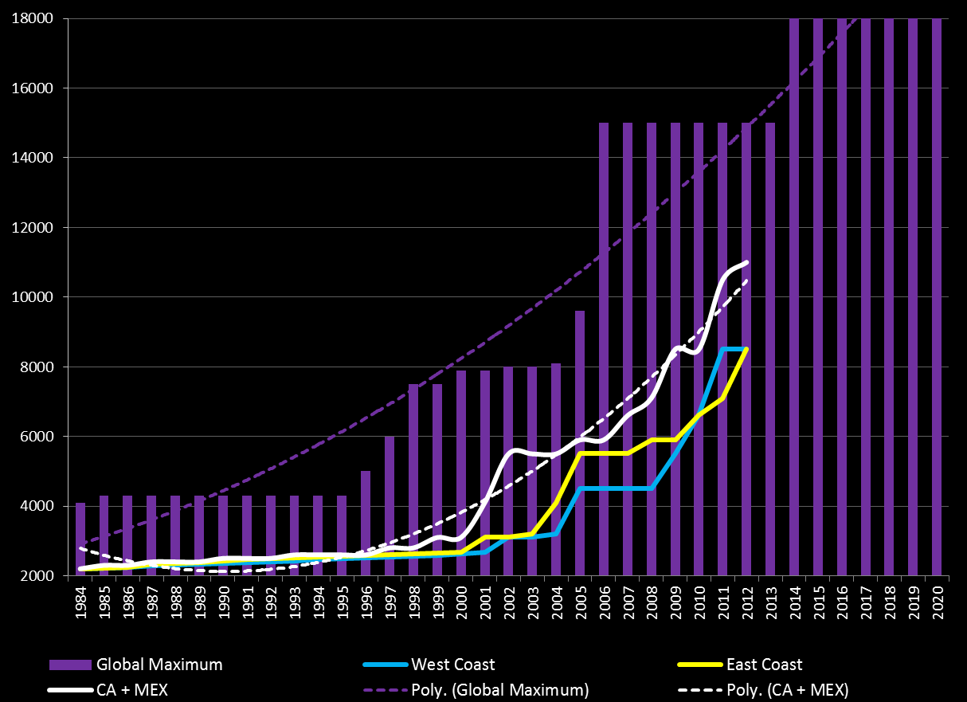
LAC: Fullcontainerships maximum size 1984-2020
Source: Sánchez &Perrotti (2012)
Notes:
An ECLAC study anticipate the arrive of vessels which capacity is +13000 TEU in South America

Slide 11
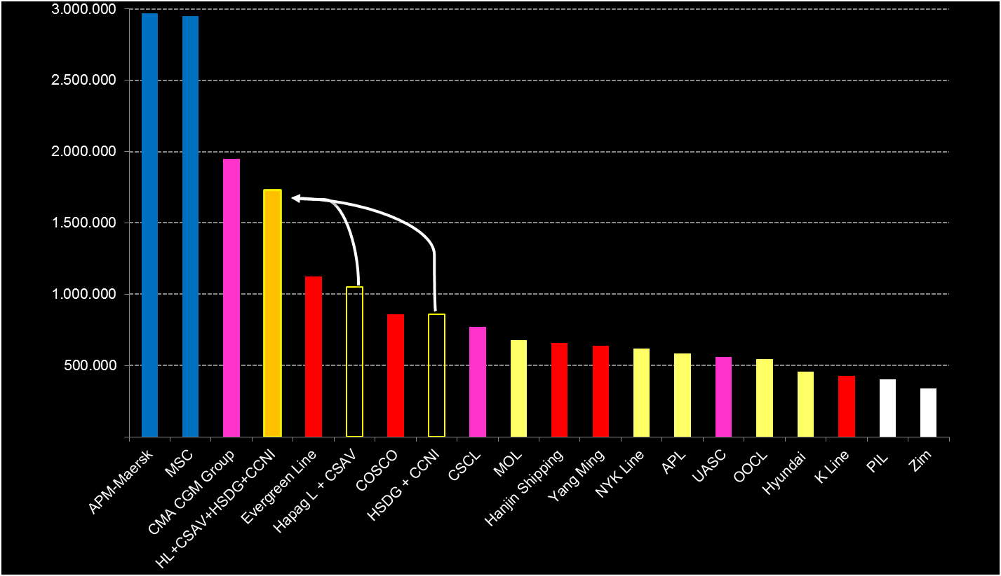
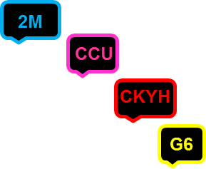
Global expected fleet: as June 2016, if…
Merger HSDG + CCNI is confirmed
O3 (CCU) is finally done…
And a double German occurs (HHCC) ??
Transatlántico
Asia - Mediterraneo
Transpacífico
y
2M
2M
G6
y
G6
CKYHE
CKYHE
OTROS
G6
2M
CMA-CGM
CMA-CGM
OTROS
CKYHE
OTROS
CMA-CGM
Notes:
Right now there is no need for any ship to speed up and all our characters are still asking ships to proceed at their eco speeds on all journeys. So, anecdotal evidence suggests that no one is speeding up. But vessels running faster than previously imply a new turmoil on the weak equilibrium between demand and supply.

Slide 12
What to think? What to do?
Logistics & Mobility Governance
Port Governance

Slide 13
Port governance: past and future
Governance 1.0
Governance 2.0
Old Dev.
Tool
Landlord
New landlord?
Goals
Instruments
ACOMPLISHMENTS
Goals
Instruments
New policies, institution & governance
Public policies

Slide 14
Governance 1.0
Governance 2.0
Tool
Landlord
New Landlord?
Public ports
Extreme modal vision
Reducing tax burden of ports
Incorporate of private equity
Increase of the competition
Improve the competitiveness of foreign trade
Centralization – decentralization
Containers
Old public ports + new
Integrated and systemic vision Rationalization
Private and public capital
Social efficiency
Competitiveness and productivity
Decentralization – centralization
All loads
Previews governance models
New institutional
New legal instruments
New associative forms
NEW GOVERNANCE

Slide 15
Port Governance
 | 2000 | 2005 | 2007 | 2009 | 2010 | 2011 | 2012 | 2013 | % 8 años | % 13 años
Millions of Containers (TEUS) | 4.39 | 11.94 | 15.45 | 16.00 | 19.34 | 22.69 | 24.56 | 24.61 | 106% | 460%
Berth Length (‘000 m) | 13.6 | 15.6 | 17.1 | 19.3 | 20.9 | 22.3 | 22.8 | 22.9 | 46% | 68%
STS Crane | 63 | 98 | 120 | 161 | 175 | 187 | 197 | 204 | 109% | 222%
Berth productivity (TEU/m) | 323 | 764 | 904 | 829 | 924 | 1019 | 1075 | 1077 | 41% | 233%
Mov x ship (Box/hr) | 19 | 29 | 31 | 37 | 38 | 40 | 42 | 44 | 60% | 136%
Source: Octavio Doerr, from different surveys and Maritime and Logistics Profile 2014, ECLAC

Slide 16
LAC: Diagnosis and major infrastructure challenges
Physical restraint & shortage => investments and funding
High dispersion and multiplicity of views in public & private action
Failures and regulatory / institutional barriers
Weakness or absence of sustainability criteria

Slide 17
Diagnosis and major infrastructure challenges in LAC
High dispersion and multiplicity of views in public action
Port Governance
Logistic & Mobility Governance

Slide 18
Main challenge!
"Volume thinking" neglects the logistic revolution, in particular the rise of product channel logistics or business logistics. What may be referred to as "logistic thinking" has a double impact on the conventional positioning of ports. The emphasis shifts from volumes to value added and from physical to logistic accessibility. (Paul Drewe)
To shift from physical to logistic accessibility means to change to a dedicated and controlled logistics accessibility.
What we need? What we have?
The change from "volume/tonnage thinking" to "logistics/chain and value-added thinking"

Slide 19
…currently, uncertainty, but: High potential! (i)
Global population (billion) Global consumption (in trillion USD)
Consuming class: daily disposable income is equal or greater $10, below consuming class, less $10; incomes adjusted for purchasing-power parity
Projected data
2025: Estimate based on 2010 private-consumption share of GDP / country and GDP estimates for 2010 and 2025, assumes private consumption will remain constant.

Slide 20
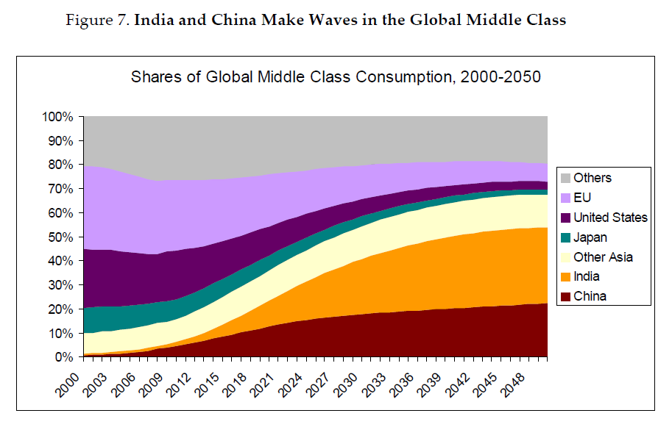
…currently, uncertainty, but: High potential! (ii)
India and China make waves in the global middle class
source: The emerging middle class in developing countries, OECD, Homi Kharas

Slide 21
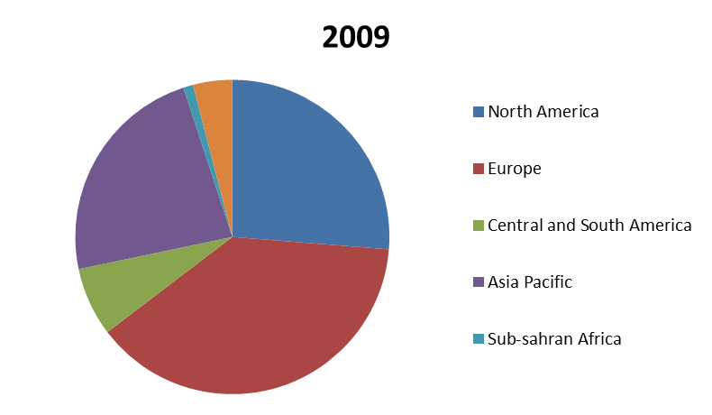
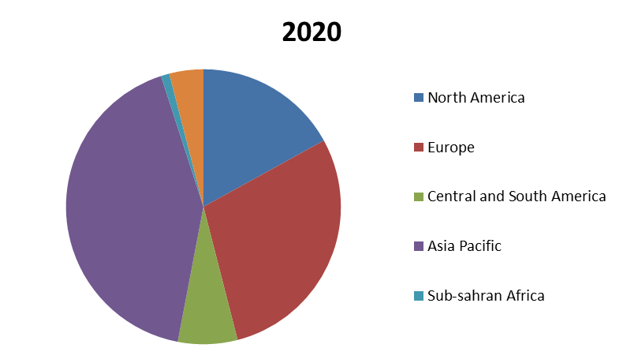
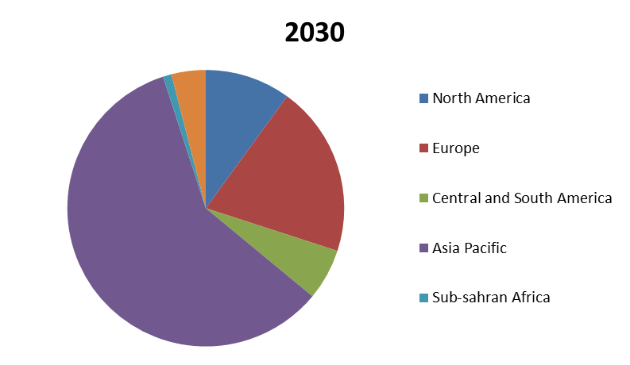
…currently, uncertainty, but: High potential! (iii)
2030
Higher dynamism in
Asia Pacific, less in LAC:
What kind of business
is benefitiated?
source: The emerging middle class in developing countries, OECD, Homi Kharas

Slide 22
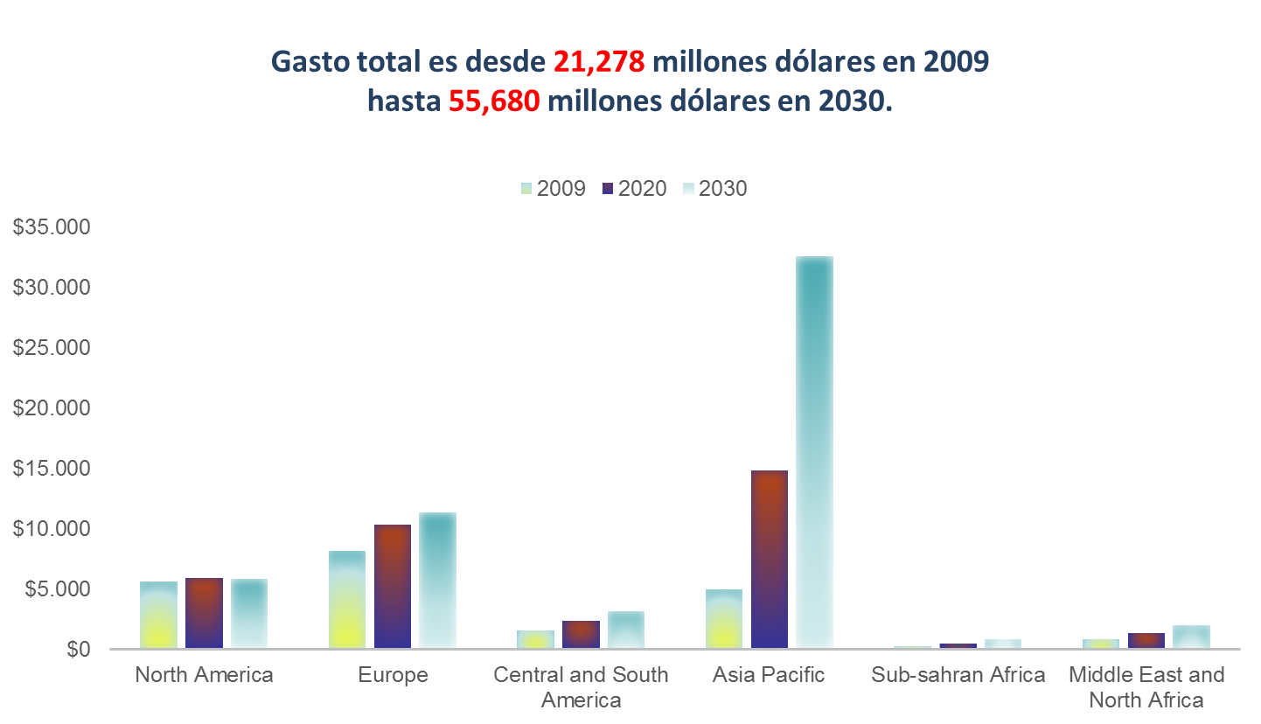
…currently, uncertainty, but: High potential! (iv)
Higher dynamism in
Asia Pacific, less in LAC:
What kind of business
is benefitiated?
source: The emerging middle class in developing countries, OECD, Homi Kharas

Slide 23


Ricardo J. Sánchez
Senior Economic Affairs Officer
Officer-in-Charge
Natural Resources and Infrastructure Division
United Nations Economic Commission for Latin America and the Caribbean
+56 2 2210-2257
Ricardo.SANCHEZ@ECLAC.org
http://www.eclac.org/transporte
Thanks a lot !!!
Client Logo

